Slide 1
Lecture 3
Software Process Models
Muhammad Qasim
BSCS (Software Engineering-I) SZABIST-Islamabad

Slide 2
Software Process Models
Waterfall
Iterative
Incremental
V Model
Spiral
Agile
BSCS (Software Engineering-I) SZABIST-Islamabad

Slide 3
The Waterfall Model
The waterfall model is a sequential approach, where each fundamental activity of a process represented as a separate phase, arranged in linear order.
When To Use?
In principle, the waterfall model should only be applied when requirements are well understood and unlikely to change radically during development as this model has a relatively rigid structure which makes it relatively hard to accommodate change when the process in underway.
BSCS (Software Engineering-I) SZABIST-Islamabad

Slide 4
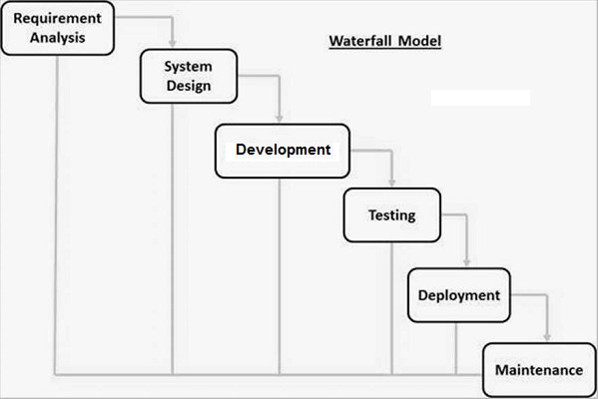
The Waterfall Model
BSCS (Software Engineering-I) SZABIST-Islamabad

Slide 5
Advantages Waterfall Model
Simple and easy to understand and use.
Easy to manage due to the rigidity of the model – each phase has specific deliverables and a review process.
Phases are processed and completed one at a time.
Works well for smaller projects where requirements are very well understood.
BSCS (Software Engineering-I) SZABIST-Islamabad

Slide 6
Disadvantages Waterfall Model
Once an application is in the testing stage, it is very difficult to go back and change something that was not well-understood in the concept stage.
No working software is produced until late during the life cycle.
High amounts of risk and uncertainty.
Not a good model for complex and object-oriented projects.
Poor model for long and ongoing projects.
Not suitable for the projects where requirements are at a moderate to high risk of changing.
The project is short.
BSCS (Software Engineering-I) SZABIST-Islamabad

Slide 7
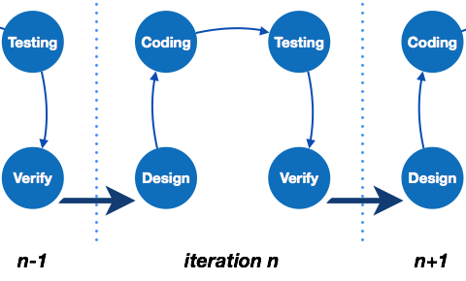
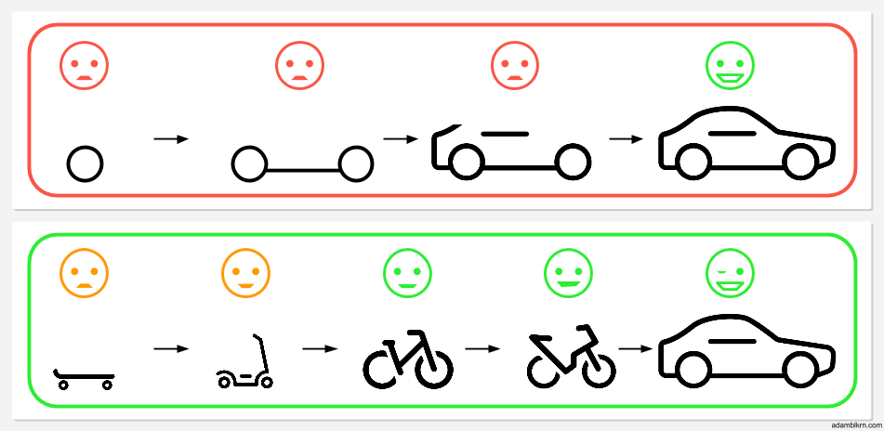
Iterative Model
Iterative development model aims to develop a system through building small portions of all the features, across all components.
BSCS (Software Engineering-I) SZABIST-Islamabad

Slide 8
Incremental Model
Incremental development is based on the idea of developing an initial implementation, exposing this to user feedback, and evolving it through several versions until an acceptable system has been developed.
BSCS (Software Engineering-I) SZABIST-Islamabad

Slide 9
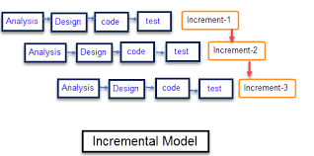
Incremental Model
BSCS (Software Engineering-I) SZABIST-Islamabad

Slide 10
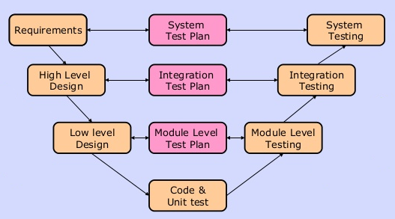
V Model
BSCS (Software Engineering-I) SZABIST-Islamabad

Slide 11

V Model
BSCS (Software Engineering-I) SZABIST-Islamabad

Slide 12
Prototype Model
Prototype is a working model of software with some limited functionality. The prototype does not always hold the exact logic used in the actual software application and is an extra effort to be considered under effort estimation.
Following is a stepwise approach explained to design a software prototype.
Steps:
Basic Requirement Identification
Developing the initial Prototype
Review of the Prototype
Revise and Enhance the Prototype
BSCS (Software Engineering-I) SZABIST-Islamabad

Slide 13
Prototype Model
There are different types of software prototypes used in the industry. Following are the major software prototyping types used widely −
Steps:
Rapid Prototyping
Evolutionary Prototyping
Incremental Prototyping
Extreme Prototyping
BSCS (Software Engineering-I) SZABIST-Islamabad

Slide 14
Prototype Model
Rapid Prototyping
This type of prototyping uses very little efforts with minimum requirement analysis to build a prototype. Once the actual requirements are understood, the prototype is discarded and the actual system is developed with a much clear understanding of user requirements.
Evolutionary Prototyping
Evolutionary Prototyping is based on building actual functional prototypes with minimal functionality in the beginning.
By using evolutionary prototyping, the well-understood requirements are included in the prototype and the requirements are added as and when they are understood.
BSCS (Software Engineering-I) SZABIST-Islamabad

Slide 15
Prototype Model
Incremental Prototyping
Incremental prototyping refers to building multiple functional prototypes of the various sub-systems and then integrating all the available prototypes to form a complete system.
Extreme Prototyping
Extreme prototyping is used in the web development domain. It consists of three sequential phases.
First, a basic prototype with all the existing pages is presented in the HTML format. Second the data processing is simulated using a prototype services layer.
Third, the services are implemented and integrated to the final prototype. This process is called Extreme Prototyping used to draw attention to the second phase of the process, where a fully functional UI is developed with very little regard to the actual services.
BSCS (Software Engineering-I) SZABIST-Islamabad

Slide 16
Spiral Model
This Spiral model is an evolutionary software process model which is a combination of iterative development process model and sequential linear development model i.e. the waterfall model with a very high emphasis on risk analysis.
Spiral Model Phases
The spiral model has four phases
Plan
Risk Analysis
Engineering
Customer evaluation
BSCS (Software Engineering-I) SZABIST-Islamabad

Slide 17
Spiral Phases
Plan
The objectives, alternatives and constraints of the project are determined and are documented.
Risk Analysis
All possible alternative, which can help in developing a cost effective project are analyzed.
This phase identify and resolve all the possible risks in the project development.
BSCS (Software Engineering-I) SZABIST-Islamabad

Slide 18
Spiral Phases
Engineering
The actual development of the project is carried out
The output of this phase is passed through all the phases iteratively in order to obtain improvements in the same.
Customer Evaluation
Developed product is passed on the customer in order to receive customer’s comments and suggestions.
BSCS (Software Engineering-I) SZABIST-Islamabad

Slide 19
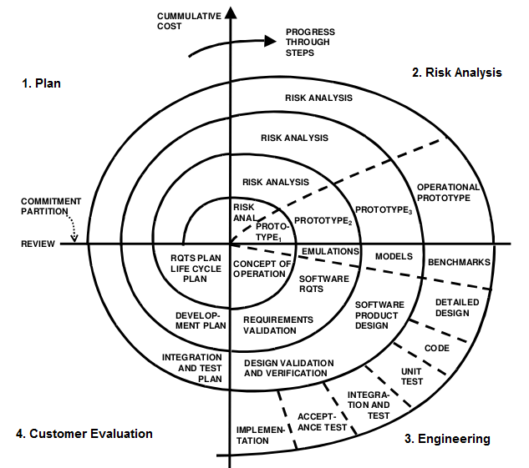
Spiral Model
BSCS (Software Engineering-I) SZABIST-Islamabad

